Slide 1
Facial Expression Recognition
Basic elements

Slide 2
Componentele retelei neurale
Definitia retelei:
Triplet (N,V,w)
  N : setul de neuroni
  V : conexiuni (synapse) intre neronii i si j
  w(i,j) – ponderea (weight) conexiunii dintre neuronii i si j
  -> W : weight matrix – Hinton diagram
neuronul, elementul de baza al retelei

Slide 3
Procesarea datelor in neuron
...
intari date de la alti neuroni
o_{i}
w_{i,j}
ponderari conexiuni
Propagation function
(uzual: suma ponderata - weighted sum)
net_{j}
network input
Activation function
(threshold Θ_{j})
a_{j}
activation
Output function
(uzual: functia identitate)
o_{i}
iesire date spre alti neuroni
...

Slide 4
Propagation function
net_{j} = f_{prop}(o_{i1}, ... o_{in} , w_{i1,j}, ... w_{in,j})
suma ponderata (weighted sum)
  cea mai populara:
  net_{j} = Σ(ο_{i} * w_{i,j})
i∈Ι
de obicei este definita global

Slide 5
Activation (transfer) function
reactia la valorile de intrare depinde de starea sa curenta de activare (activation state) a_{j} si de valoarea de prag (threshold) Θ_{j}
    a_{j}(t) = f_{act}(net_{j}(t), a_{j}(t-1), Θ_{j+})
Functii de activare:
  Hyperbolic tangent function
  Fermi function ( logistic function, sigmoid fnc)
  Softmax Function
  Stochastic activation function

Slide 6
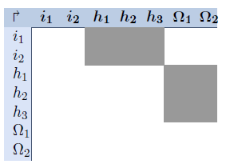
Topologii ale retelelor
diagrama Hinton
Retele nerecurente (feedforward networks)
  straturi (layers):
    strat de intrare (input layer)
    n straturi de procesare ascunse (hidden layers)
    strat de iesire (output layer)
nerecursive: numai deasupra diagonalei
Retele recurente (recurrent networks)
    recurenta directa (self-reccurence) diagonala matricei W: w_{j,j} ≠ 0
    recurenta indirecta (indirect reccurence) - termeni ≠ 0 sub diagonala principala a matricei W

Slide 7
Proceduri de invatare
Invatare supravegheata (supervised learning)
  Antrenare (training)
Invatare nesupravegheata (unsupervised learning)
  reteaua identifica patternuri similare pe care sa le clasifice in categorii similare.
Invatare semi-supravegheata (semi-supervised learning)
  labeled data
  unlabeled data

Slide 8
Invatare supravegheata (supervised learning)
Antrenare (training)
    P – trainig set – set finit de perechi (p,t) - epoch
      p – vectorul de intrare (input pattern),
      t - vectorul de iesire dorit (training input)
Etapele invatarii:
  se aplica vectorul de intrare (input pattern)
  datele de intrare se propaga prin retea pana se genereaza iesirea
  se compara iesirea cu vectorul de iesire dorit (teaching input) – se calculeza vectorul diferenta – vectorul de eroare
  se calculeza corectiile retelei in functie de vectorul de eroare
  se aplica corectiile calculate la retea
  criteriul de progres: eroarea patratica medie (uzual)

Slide 9
Retele neurale - invatarea
Legea retro-propagarii erorii (backpropagation rule of error)
Δw_{k,h}(t) = ηo_{k}δ_{h} + μ Δw_{k,h}(t-1) cu:
f ’_{act}(net_{h}).(t_{h}-y_{h}) - pentru h exterior
δ_{h} =
f ’_{act}(net_{h}).Σ_{l}∈_{L}(δ_{l}w_{h,l}) – pentru h interior
conform patternului de invatare P,t - variatia ponderii dintre neuronii k si h este proportionala cu:
rata de invatare (learning rate) η
μ - momentul
- iesirea neuronului predecesor o_{k}
- gradientul functiei de activare a neuronului succesor h
- suma variatiilor ponderilor pentru toti neuronii care urmeaza lui h

Slide 10
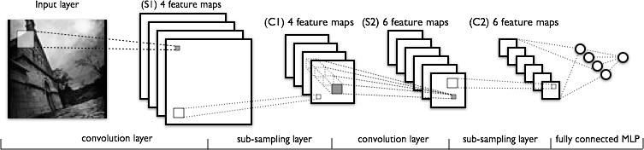
Convolutional Networks (deep network)
se aplica pe aceleiasi zona de imagine mai multe filtre.
filtrul este compus dintr-o matrice patrata la care termenii sunt ponderi ale filtrului. - se face convolutie spatiala cu acest filtru.
- rezulatul filtrarii se numeste feature map (FM). - exista atatea FM cate filtre am aplicat. – aceasta reprezinta adancimea retelei
fiecare convolution layer este urmat de un sub-sampling layer.

Slide 11
Facial Expression Recognition (FER)- metode
Sintetice
  Deep Convolution Neural Network (DCNN)
  bazate pe Fourrier Transform (FT) – Gabor Transform
    FT 2D a functiei ponderate cu functia Gaussiana: n X m
Analitice
  Facial Action Coding System (FACS): codificarea expresiilor faciale - set AU Action Units (AU) – bazate pe grupe de muschi faciali

Slide 12
Facial Expression Recognition - metode
Statice
  bazate pe Naive-Bayes Classifier (NBC)
    curbe Bayes
    practice – expresii faciale independente
Dinamice (temporale)
  Hidden Markov Models (HMM)
Mixte
  Motion Unit (MU)

Slide 13
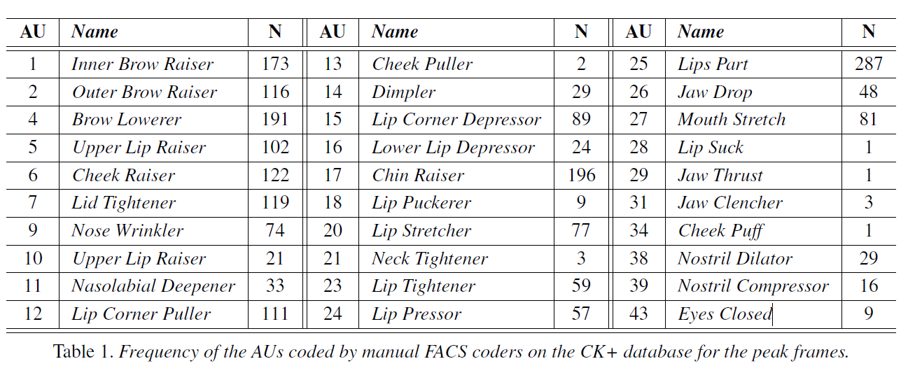
FER - Action Units (AU)

Slide 14
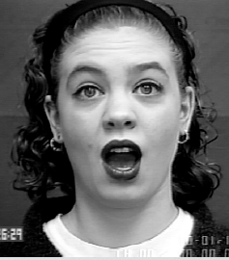
FER - Action Units (AU)
Exemplu de codificare a expresiei faciale cu AU:
Surprise - AU 1+2+5+25+27

Slide 15
FER - Action Units (AU)

Slide 16
FER – Motion Unit (MU)
1 | Vertical movement of the center of upper lip
2 | Vertical movement of the center of lower lip
3 | Horizontal movement of left mouth corner
4 | Vertical movement of left mouth corner
5 | Horizontal movement of right mouth corner
6 | Vertical movement of right mouth corner
7 | Vertical movement of right brow
8 | Vertical movement of left brow
9 | Lifting of right cheek
10 | Lifting of left cheek
11 | Blinking of right eye
12 | Blinking of left eye

Slide 17
FER – analytics metods
Face Tracker (FT)
  facial detection
  facial features extraction : AU
Classifier – Neural Network
  AU sau MU – eventual preprocesate...
  output: universal emotions:
    Happiness, Sadness, Anger, Disgust, Surprise, Fear.
  training: Facial Databases

Slide 18
FER – Facial Databases
Cohn-Kanade database
  initial release: 486 sequences from 97 subjects. (640 X 490 pxs).Sequence: neutral expression ... peak expression. The peak expression for each sequence in fully FACS
Caltech Faces (California Institute of Technology.)
  450 frontal face of 27 or more subjects with different expressions (896 x 592 pxs)
Georgia Tech Face Database
  50 subjects (150 X 150 pxs)
Facial Expressions and Emotion Database
  18 subjects

Slide 19
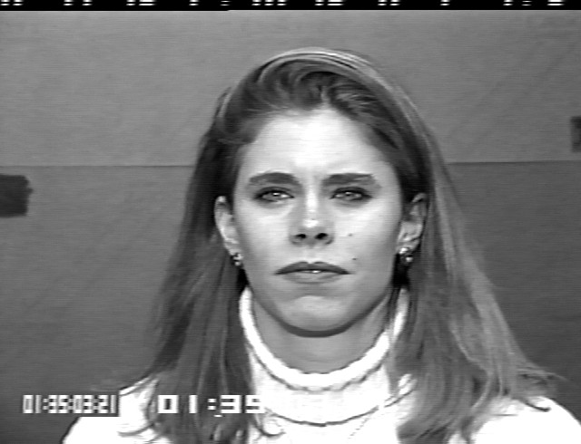
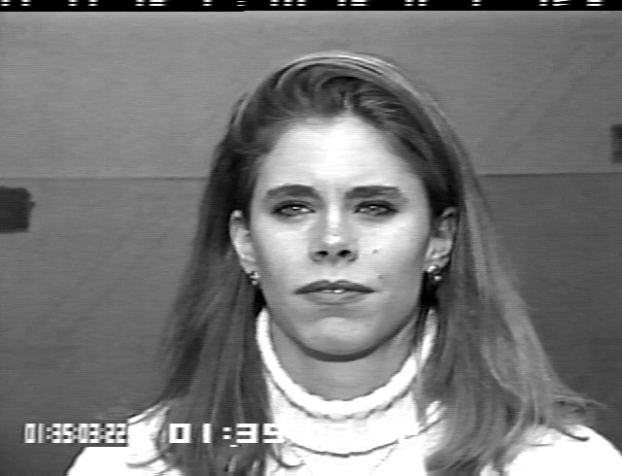







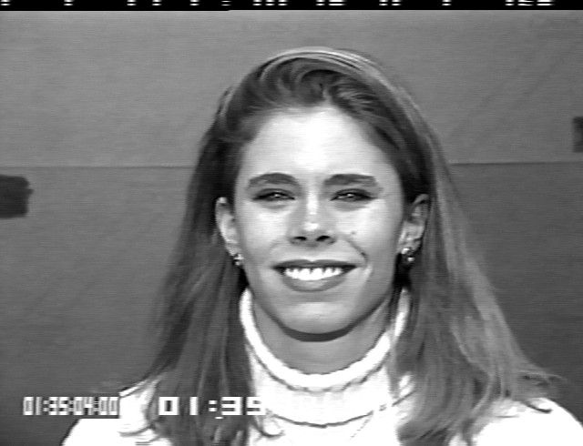





FER - Cohn-Kanade database
Subject 32, seq. 006 : AU 6 + 12 + 25 – label: Happiness

Slide 20
FT- OpenFace
OpenFace – GitHub
  open source: MatLab, C++
  inputs: image files, video files, camera
  outputs:
    Facial Appereance
    Facial Landmark, head pose, eye gaze
    Facial Action Units (AU)
  options:
    Neural Netwok input
    Interactive applications
    Saving to Disk
Demo

Slide 21
Face Tracker – OpenFace - algorithms
CLNF - Conditional Local Neural Fields , for facial landmark detection and tracking. (instance of a Constrained Local Model (CLM)):
  PDM - Point Distribution Model (captures landmark shape variations)
  patch experts (capture local appearance variations of each landmark)
LK-SVM - Linear Kernel Support Vector Machine
  for AU presence prediction and intensity

Slide 22
Classifier – Neural Netwok- CNTK
Computational Network Toolkit (CNTK)
Kitul permite configurarea si crearea a diverse tipuri de retele:
  Deep Neural Networks (DNNs)
  Recurrent Neural Networks (RNNs)
  Long Short Term Memory networks (LSTMs)
  Convolutional Neural Networks (CNNs)
  Deep Structured Semantic Models (DSSMs)
Rularea se poate face pe CPU si/sau GPU (utilizeaza librarii specifice NVIDIA).
Kitul permite antrenarea si testarea retelei.

Slide 23
Propunere pentru Neural Network
input layer: AU (43)
hidden layers: 1 – 2
out layer: Universal Emotions (6)
activation function: sigmoid
parameters: learnig rate, momentum, sigmoid constant

Slide 24
Bibliografie
http://www.ifp.illinois.edu/~iracohen/publications/icpr02.pdf
http://www.sciencedirect.com/science/article/pii/S107731420300081X
http://www2.units.it/ipl/students_area/imm2/files/Numerical_Recipes.pdf
https://github.com/Microsoft/CNTK/wiki/CNTK-Binary-Download-and-Configuration
https://en.wikipedia.org/wiki/Facial_Action_Coding_System
http://www.consortium.ri.cmu.edu/ckagree/
https://github.com/TadasBaltrusaitis/OpenFace/wiki
http://www.cl.cam.ac.uk/research/rainbow/projects/openface/

